Slide 1

Domain: Transportation & Mobility
GOODCABS

Slide 2

PROBLEM STATEMENT
Goodcabs, a cab service company established two years ago, has gained a strong foothold in the Indian market by focusing on tier-2 cities. Unlike other cab service providers, Goodcabs is committed to supporting local drivers, helping them make a sustainable living in their hometowns while ensuring excellent service to passengers. With operations in ten tier-2 cities across India, Goodcabs has set ambitious performance targets for 2024 to drive growth and improve passenger satisfaction.
As part of this initiative, the Goodcabs management team aims to assess the company’s performance across key metrics, including trip volume, passenger satisfaction, repeat passenger rate, trip distribution, and the balance between new and repeat passengers.
However, the Chief of Operations, Bruce Haryali, wanted this immediately but the analytics manager Tony is engaged on another critical project. Tony decided to give this work to Peter Pandey who is the curious data analyst of Goodcabs. Since these insights will be directly reported to the Chief of Operations, Tony also provided some notes to Peter to support his work.

Slide 3
PROVIDED DATASETS
trips_db
dim_city
dim_date
fact_passenger_summary
dim_repeat_trip_distribution
fact_trips
targets_db
city_target_passenger_rating
monthly_target_new_passengers
monthly_target_trips

Slide 4
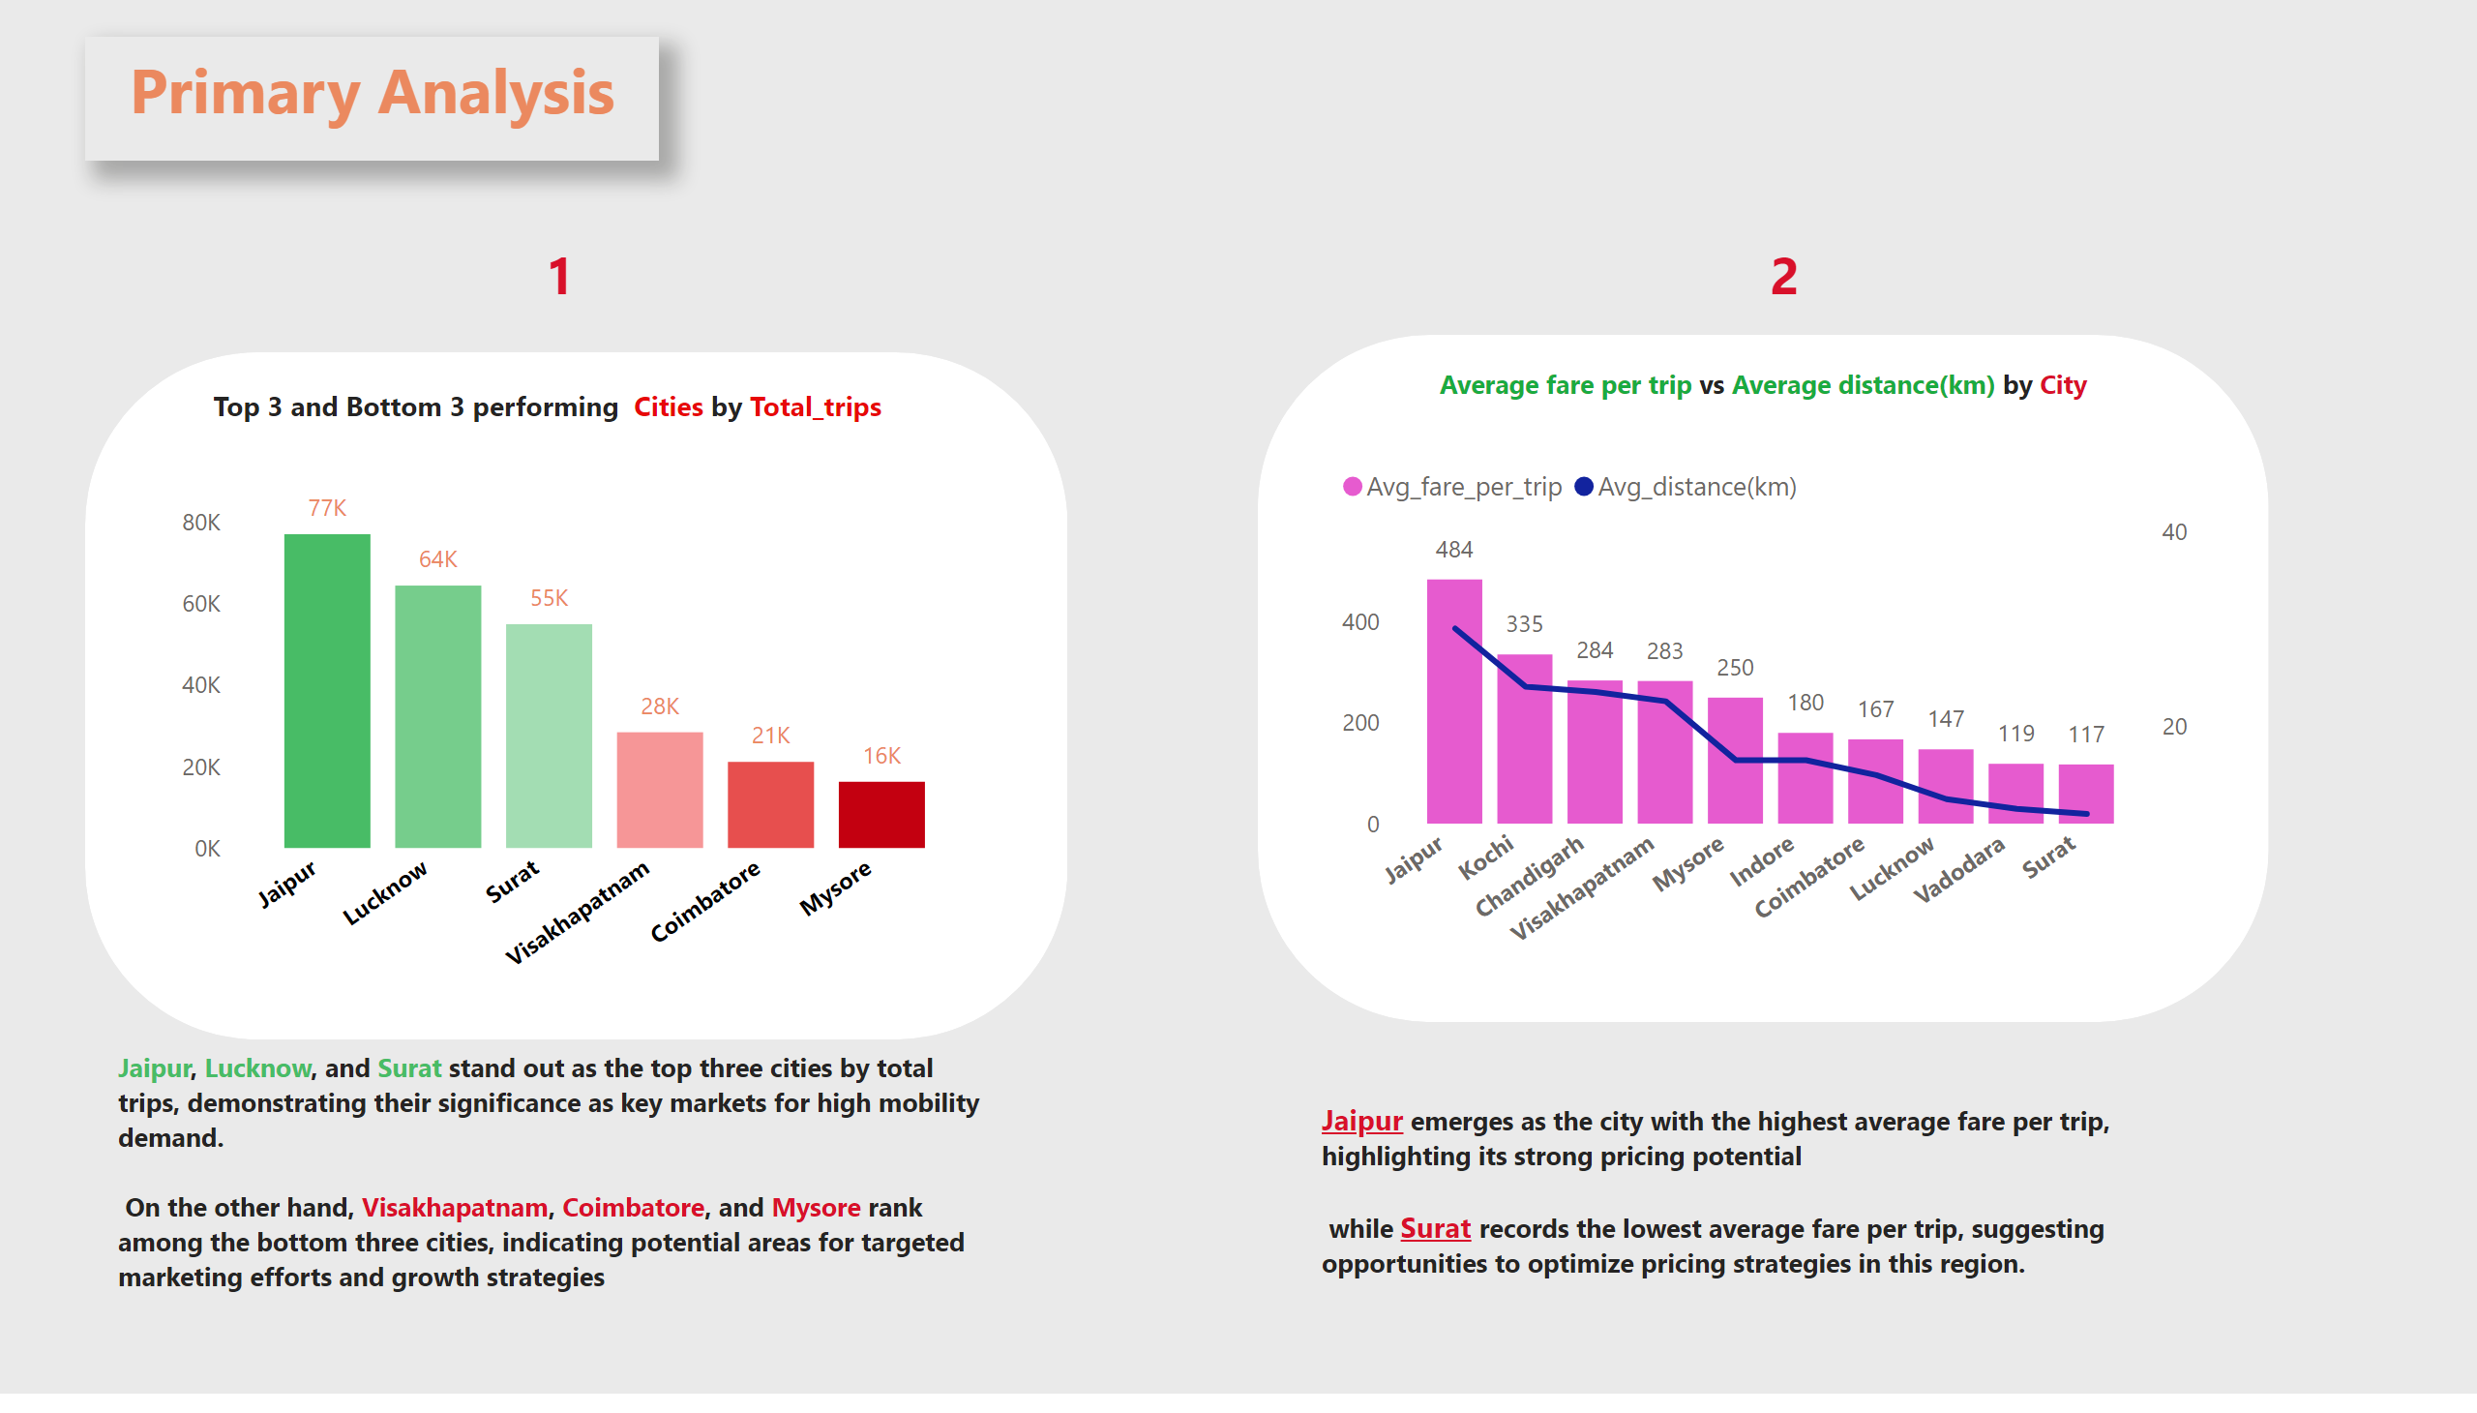
p1 & p2
Notes:
columnChart
No alt text provided
shape
No alt text provided
textbox
No alt text provided
shape
No alt text provided
lineClusteredColumnComboChart
No alt text provided
textbox
No alt text provided
textbox
No alt text provided
textbox
No alt text provided
textbox
No alt text provided
textbox
No alt text provided
textbox
No alt text provided

Slide 5
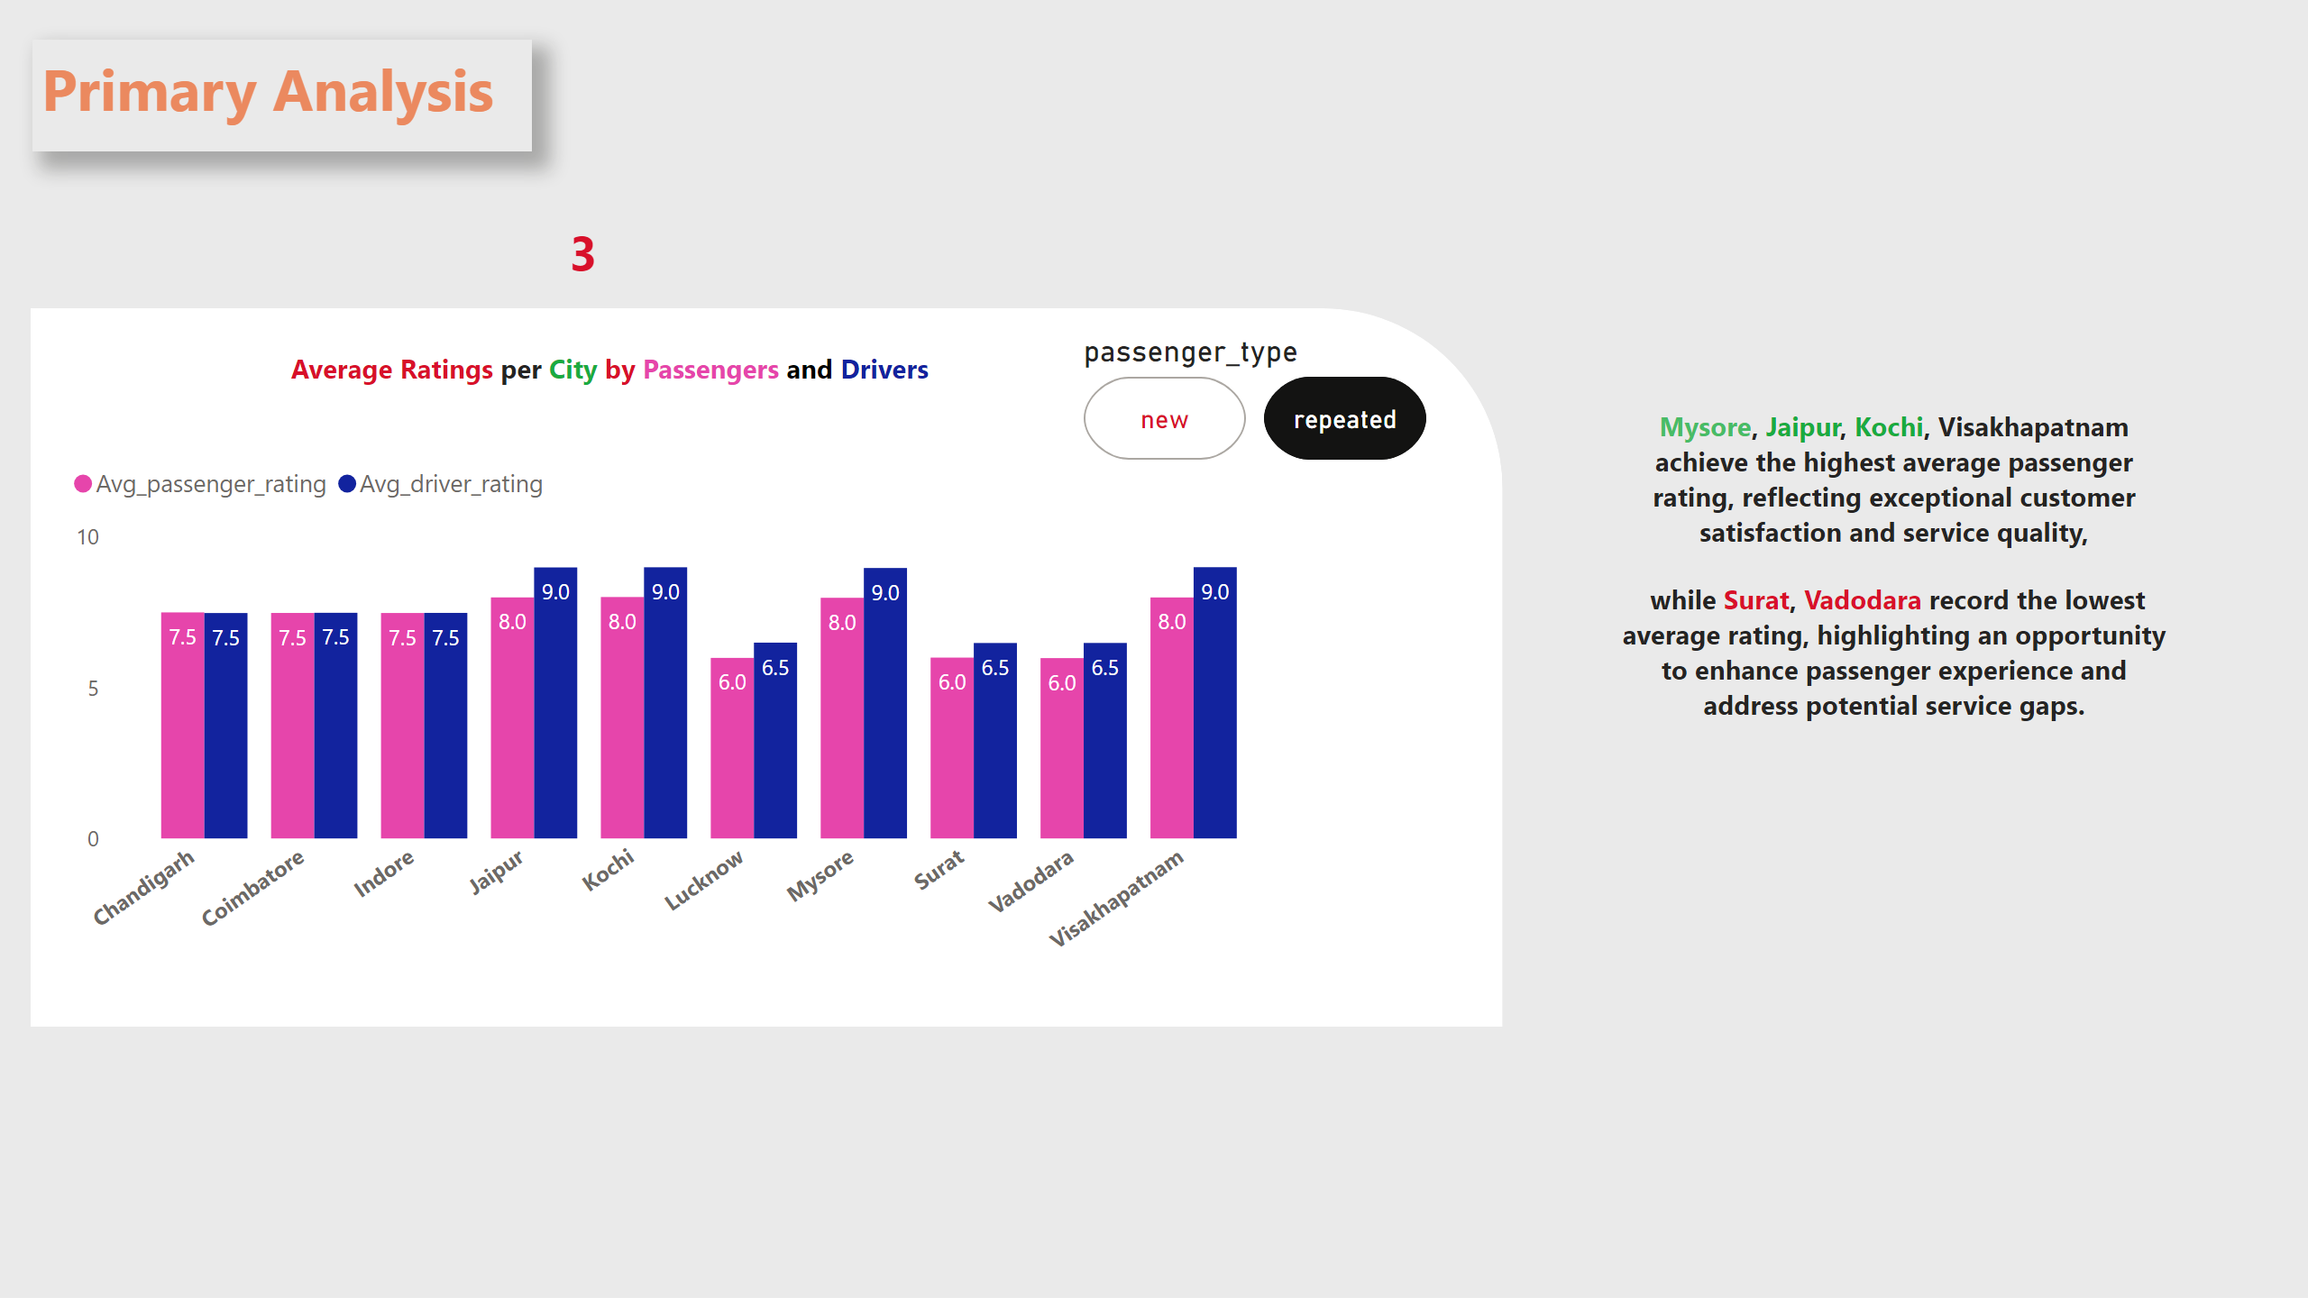
p3
Notes:
textbox
No alt text provided
textbox
No alt text provided
shape
No alt text provided
clusteredColumnChart
No alt text provided
textbox
No alt text provided
advancedSlicerVisual
No alt text provided
textbox
No alt text provided

Slide 6
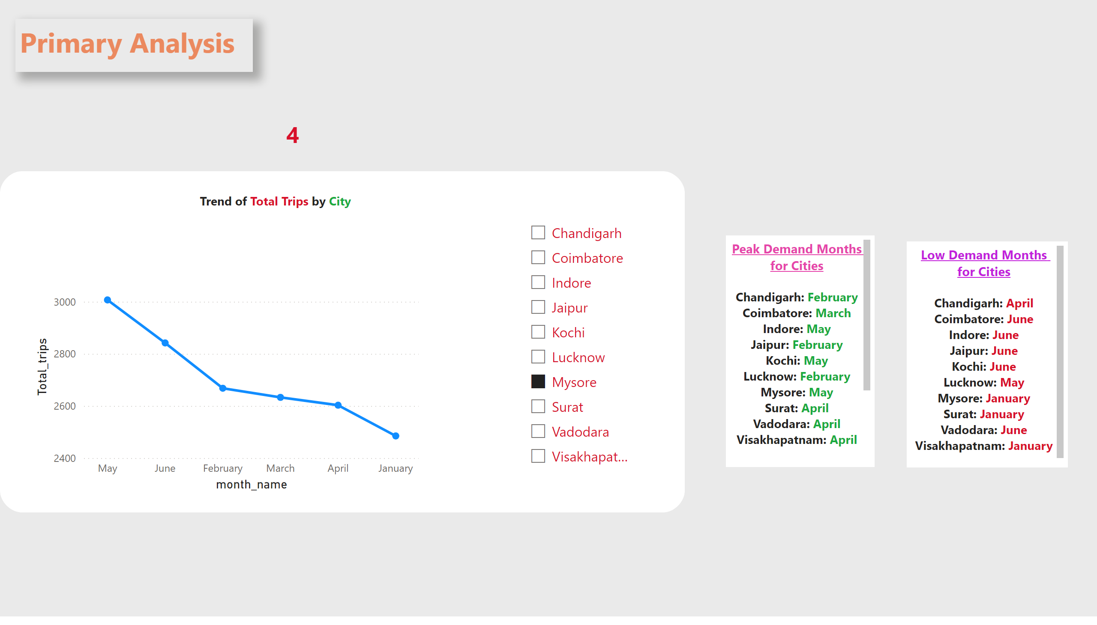
p4
Notes:
textbox
No alt text provided
textbox
No alt text provided
shape
No alt text provided
textbox
No alt text provided
lineChart
No alt text provided
slicer
No alt text provided
textbox
No alt text provided
textbox
No alt text provided

Slide 7
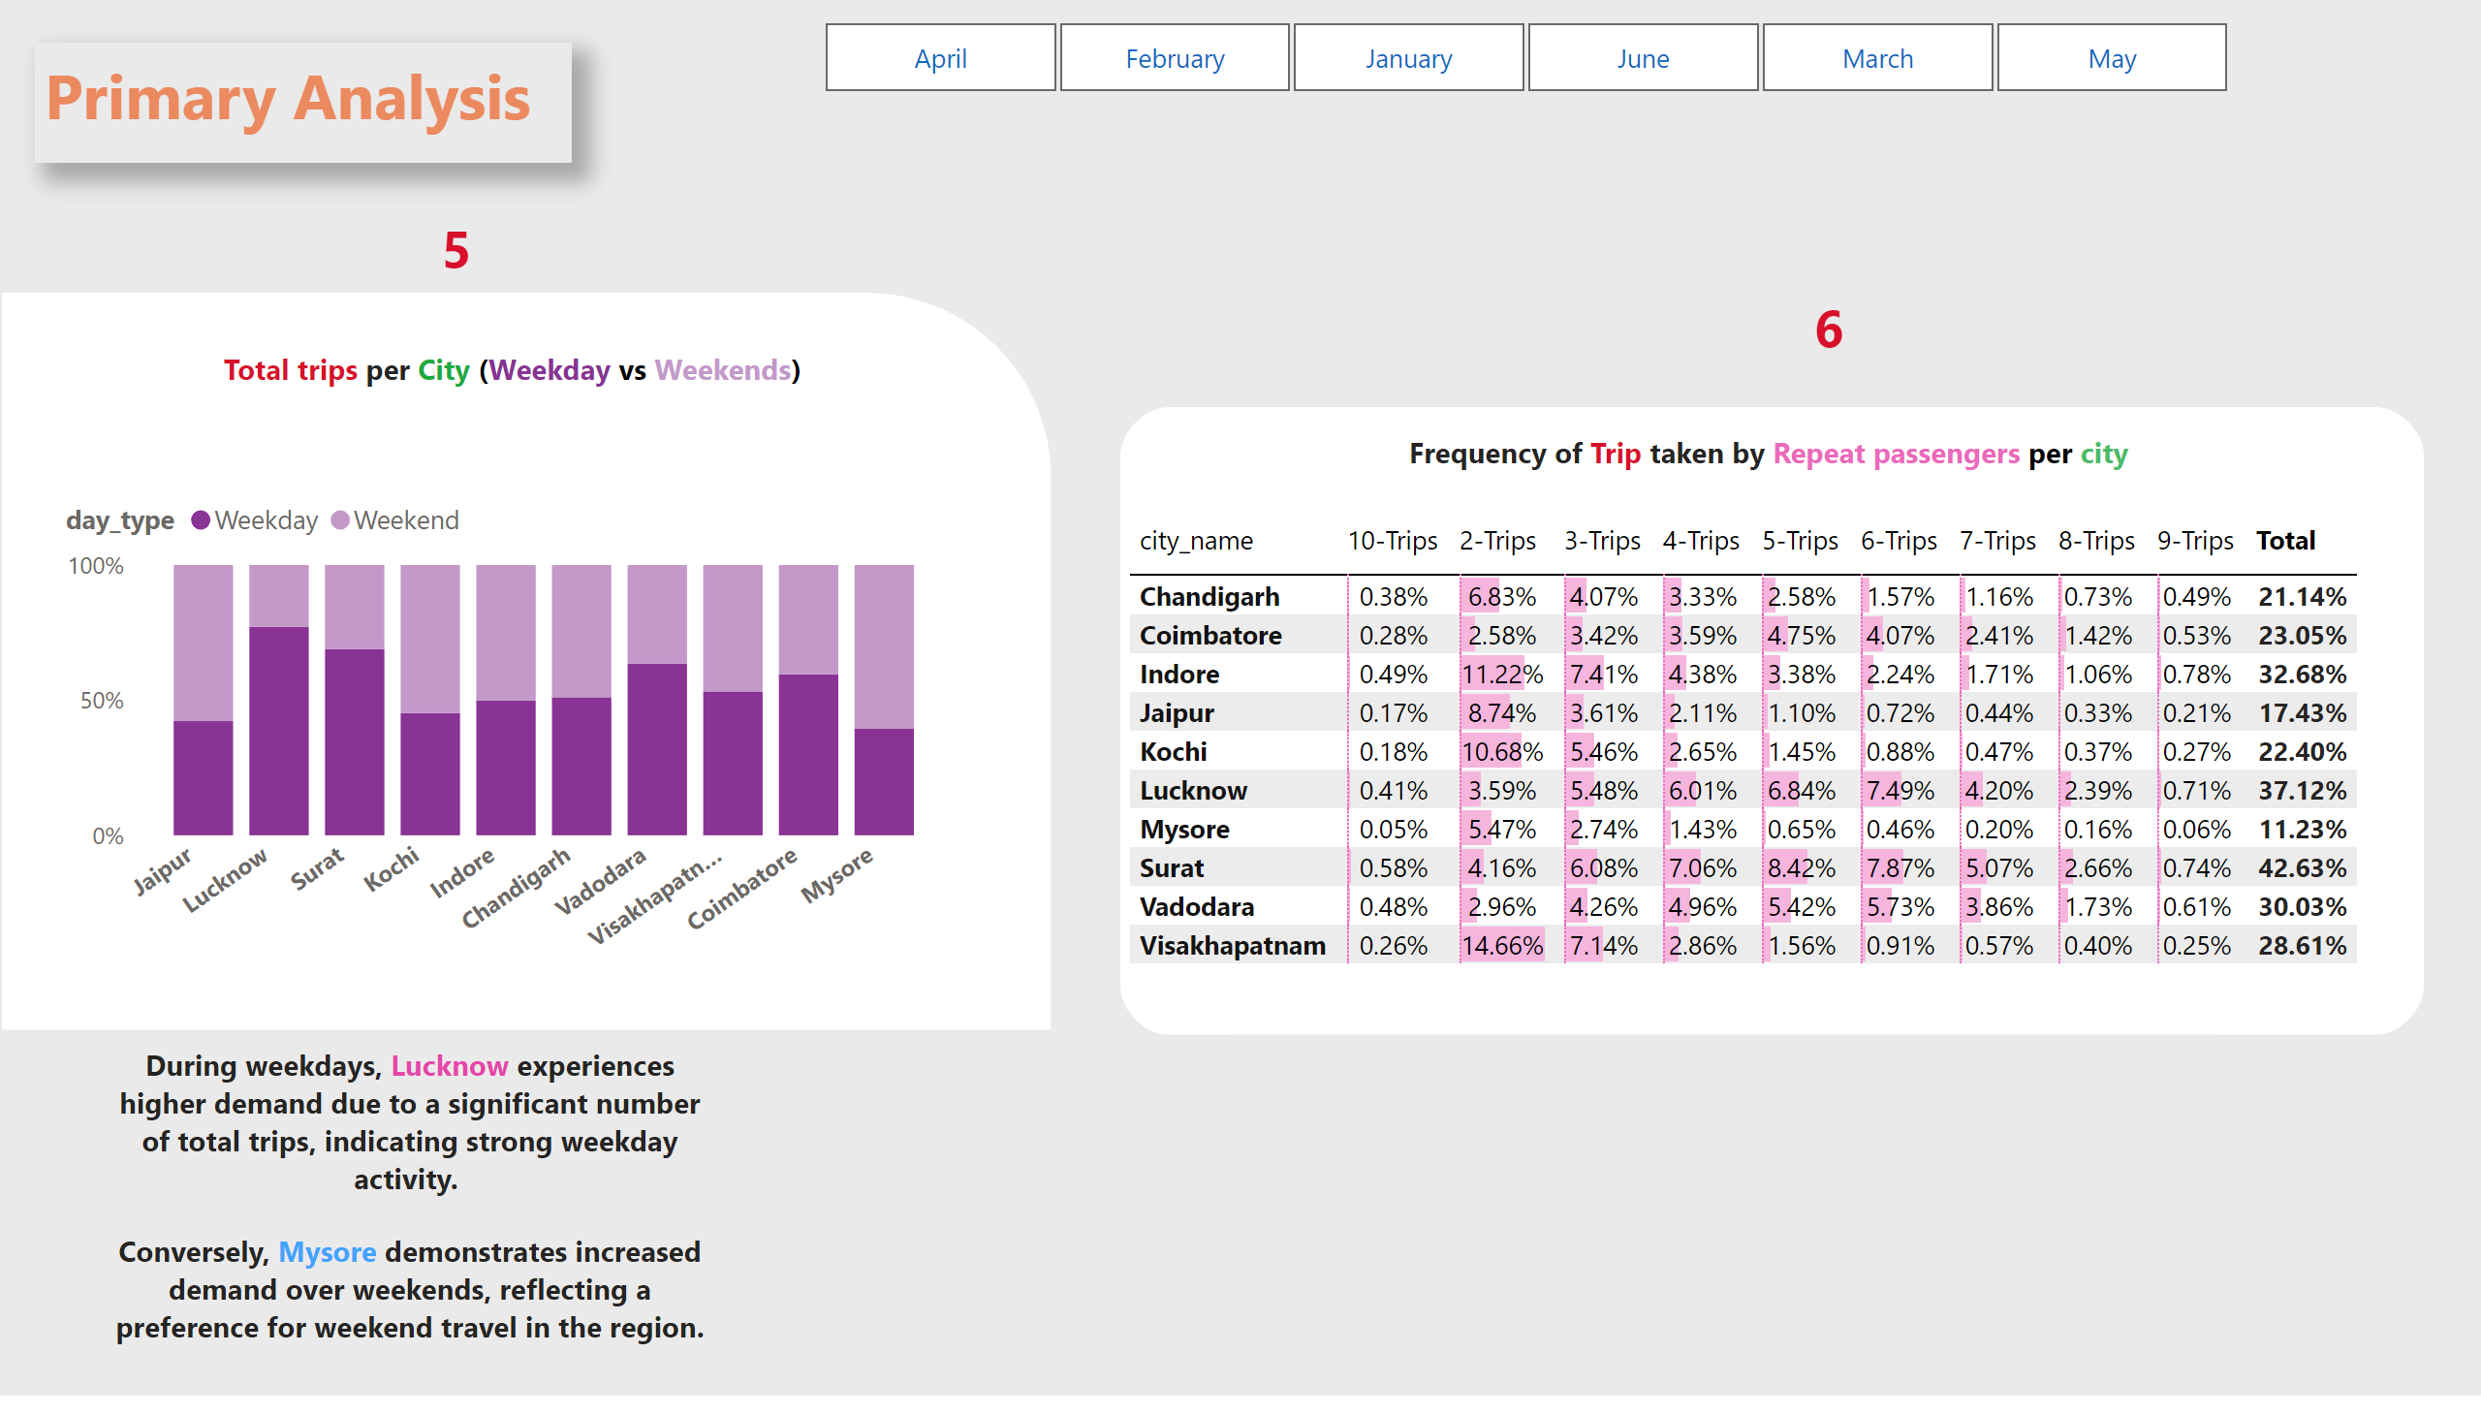
P5 & p6
Notes:
textbox
No alt text provided
textbox
No alt text provided
shape
No alt text provided
textbox
No alt text provided
textbox
No alt text provided
hundredPercentStackedColumnChart
No alt text provided
slicer
No alt text provided
shape
No alt text provided
pivotTable
No alt text provided
textbox
No alt text provided
textbox
No alt text provided

Slide 8
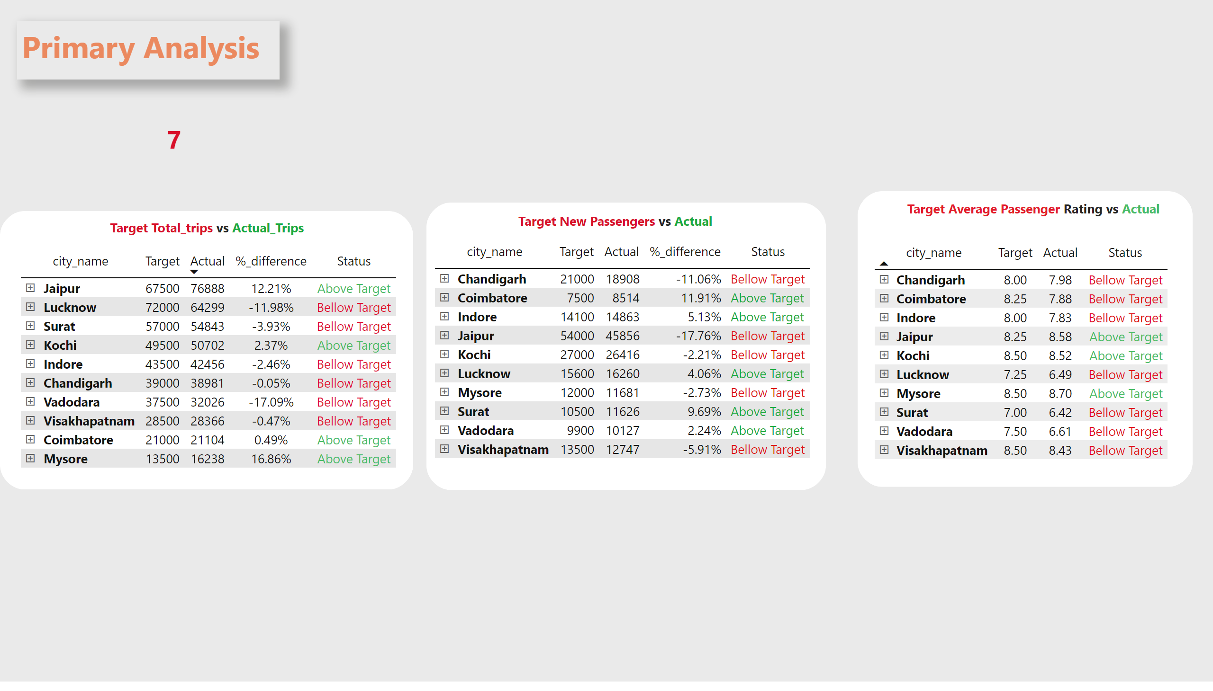
P7
Notes:
textbox
No alt text provided
textbox
No alt text provided
shape
No alt text provided
textbox
No alt text provided
pivotTable
No alt text provided
shape
No alt text provided
pivotTable
No alt text provided
textbox
No alt text provided
shape
No alt text provided
pivotTable
No alt text provided
textbox
No alt text provided

Slide 9
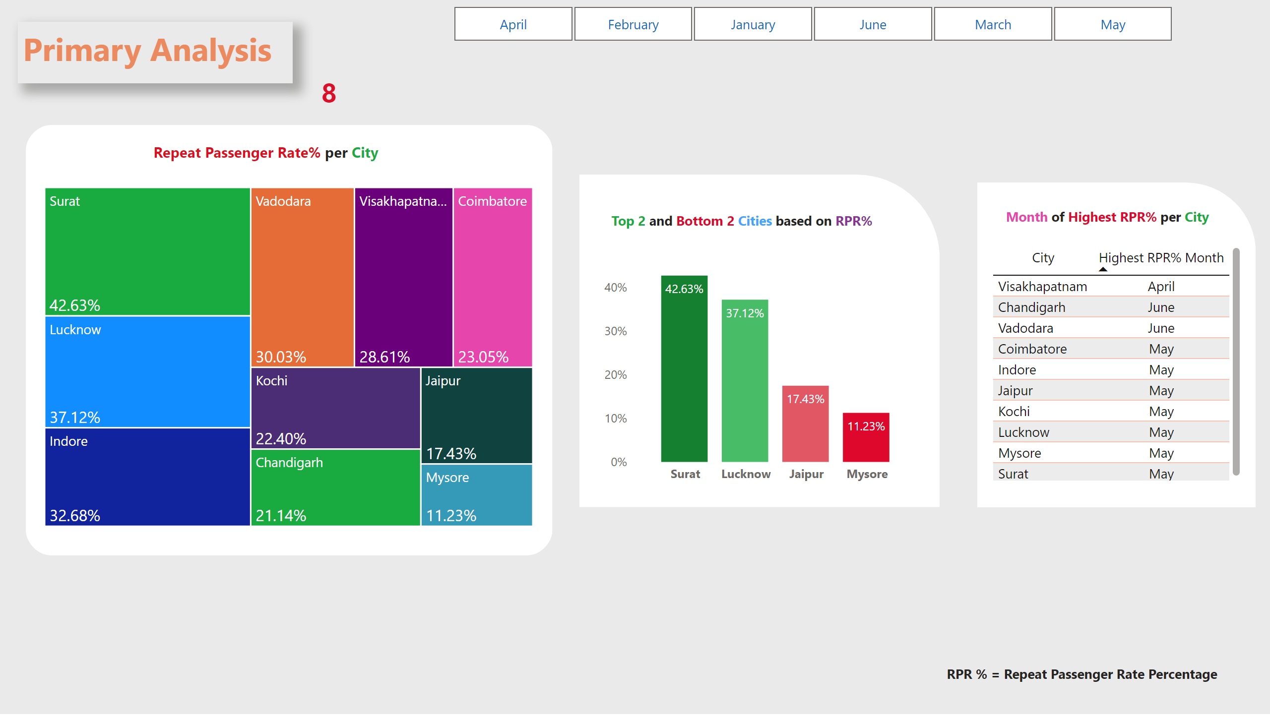
p8
Notes:
textbox
No alt text provided
textbox
No alt text provided
shape
No alt text provided
slicer
No alt text provided
textbox
No alt text provided
treemap
No alt text provided
shape
No alt text provided
columnChart
No alt text provided
textbox
No alt text provided
shape
No alt text provided
tableEx
No alt text provided
textbox
No alt text provided
textbox
No alt text provided

Slide 10
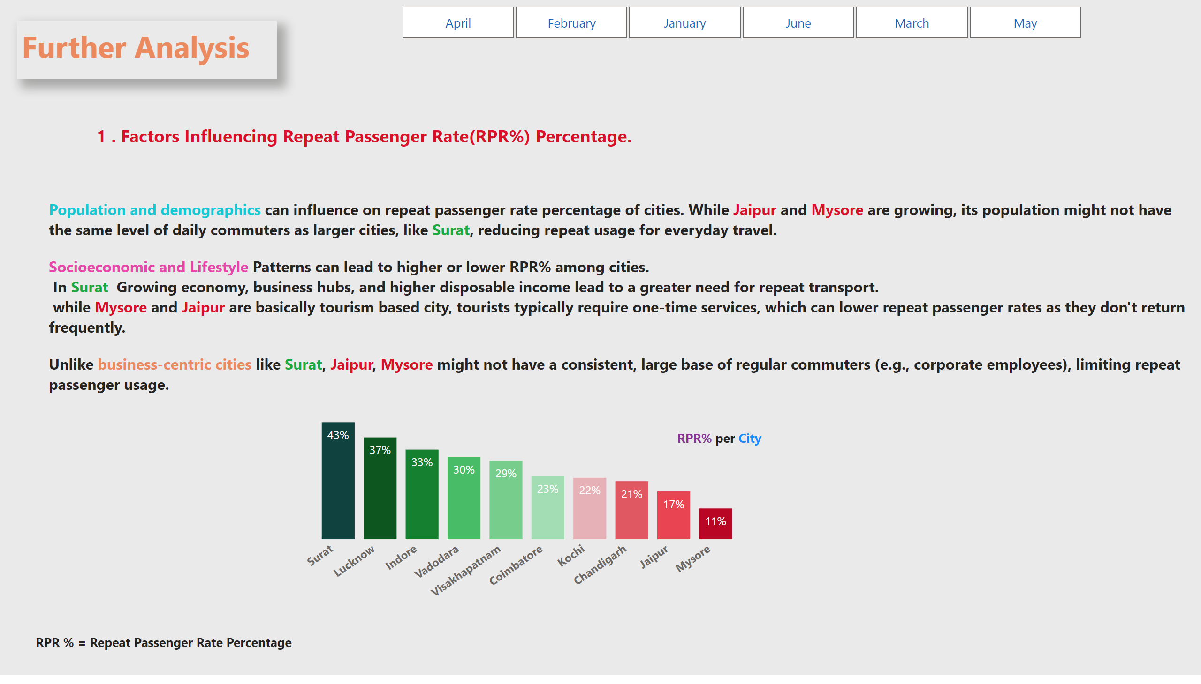
f1
Notes:
textbox
No alt text provided
slicer
No alt text provided
textbox
No alt text provided
textbox
No alt text provided
columnChart
No alt text provided
textbox
No alt text provided
textbox
No alt text provided

Slide 11
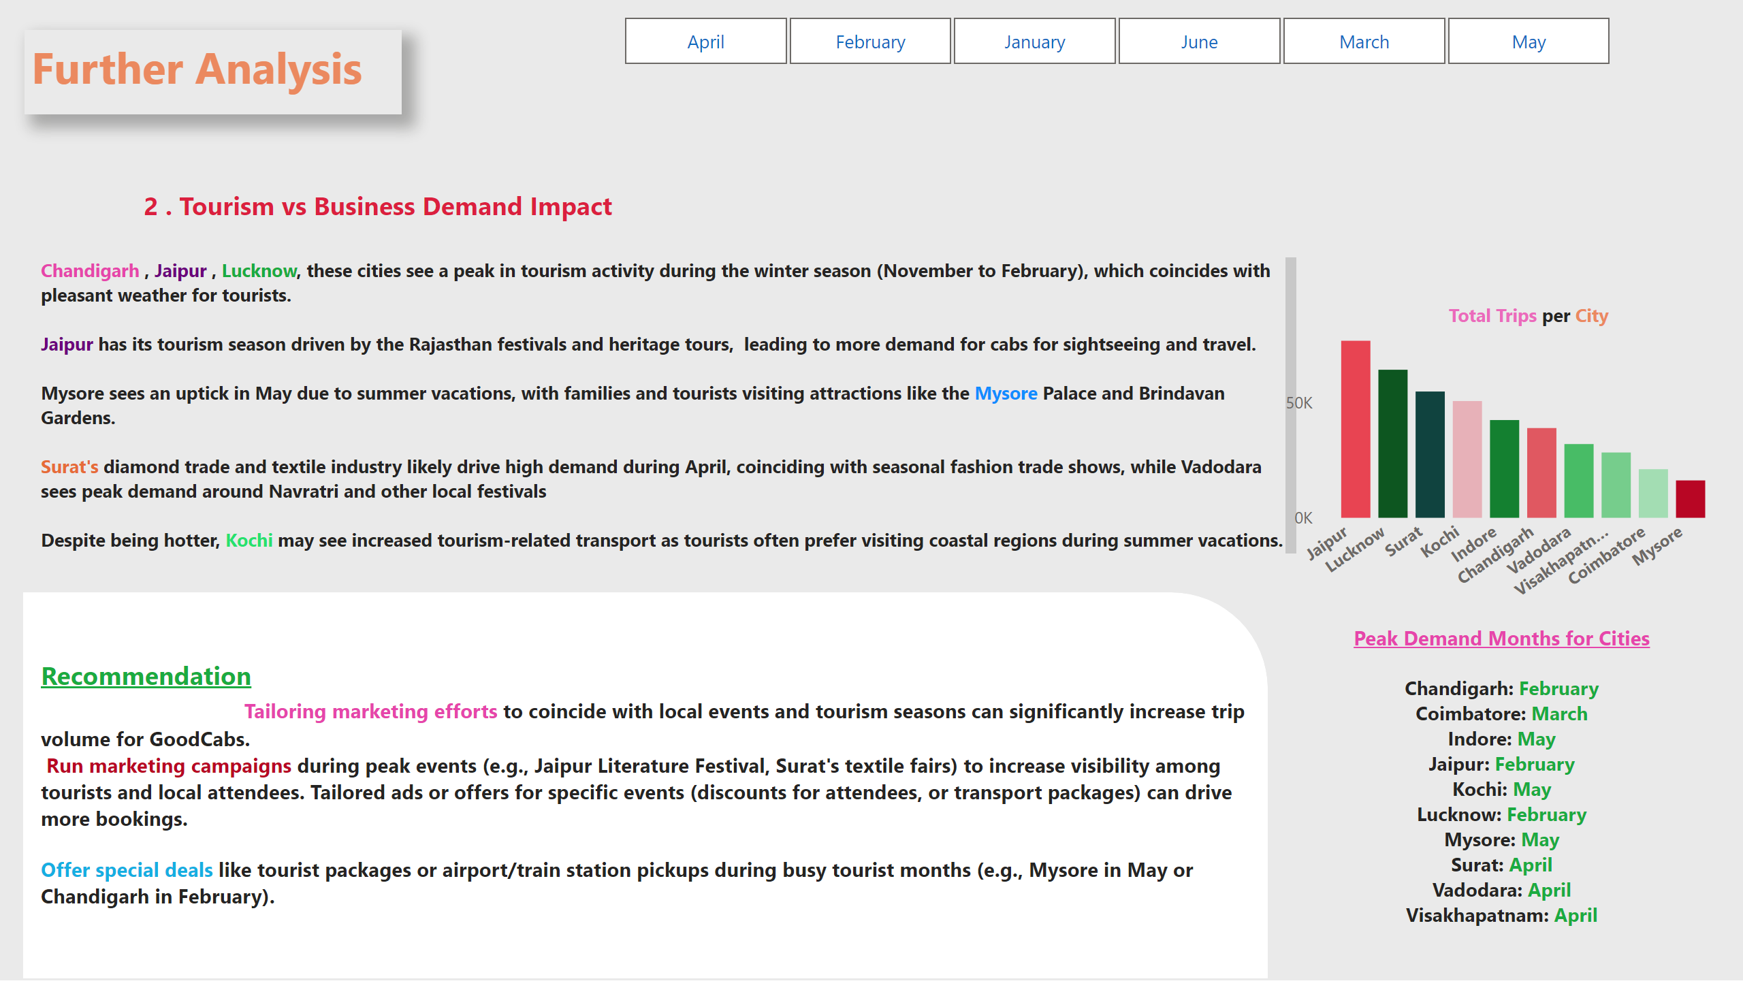
f2
Notes:
textbox
No alt text provided
slicer
No alt text provided
textbox
No alt text provided
textbox
No alt text provided
textbox
No alt text provided
textbox
No alt text provided
shape
No alt text provided
clusteredColumnChart
No alt text provided
textbox
No alt text provided

Slide 12
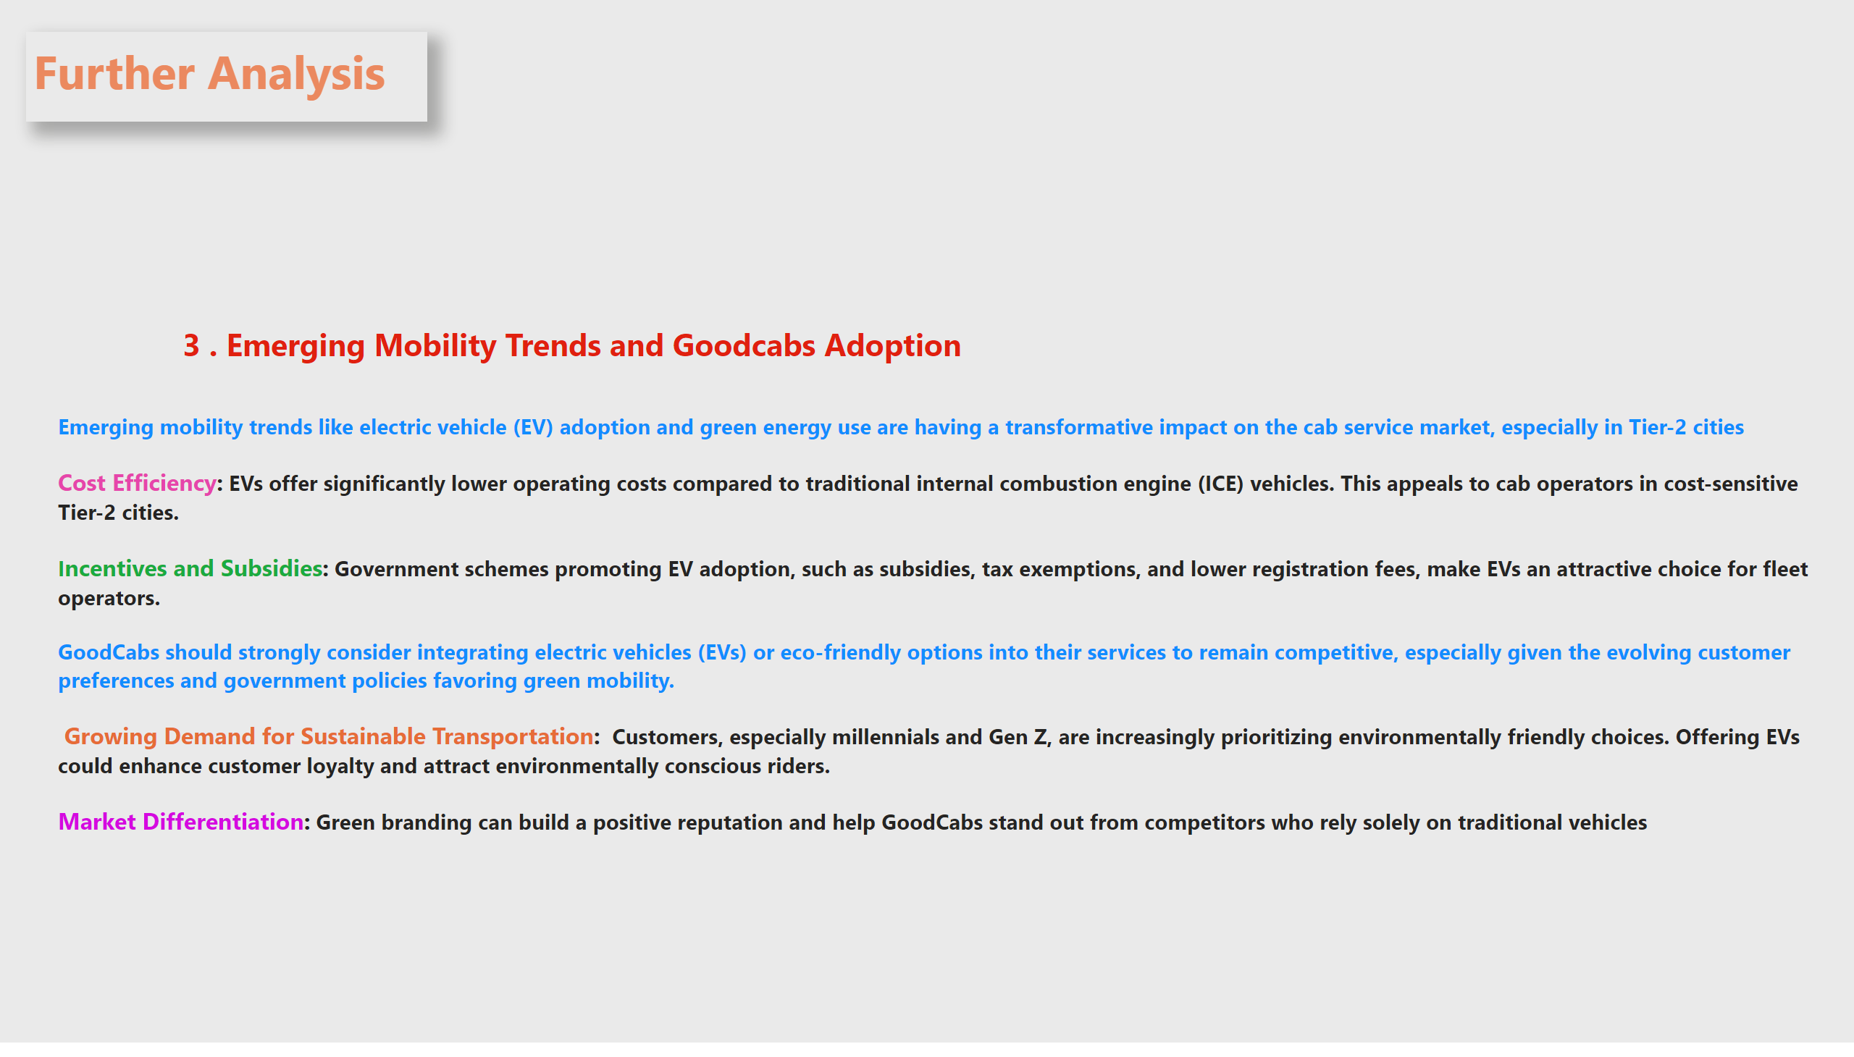
f3
Notes:
textbox
No alt text provided
textbox
No alt text provided
textbox
No alt text provided

Slide 13
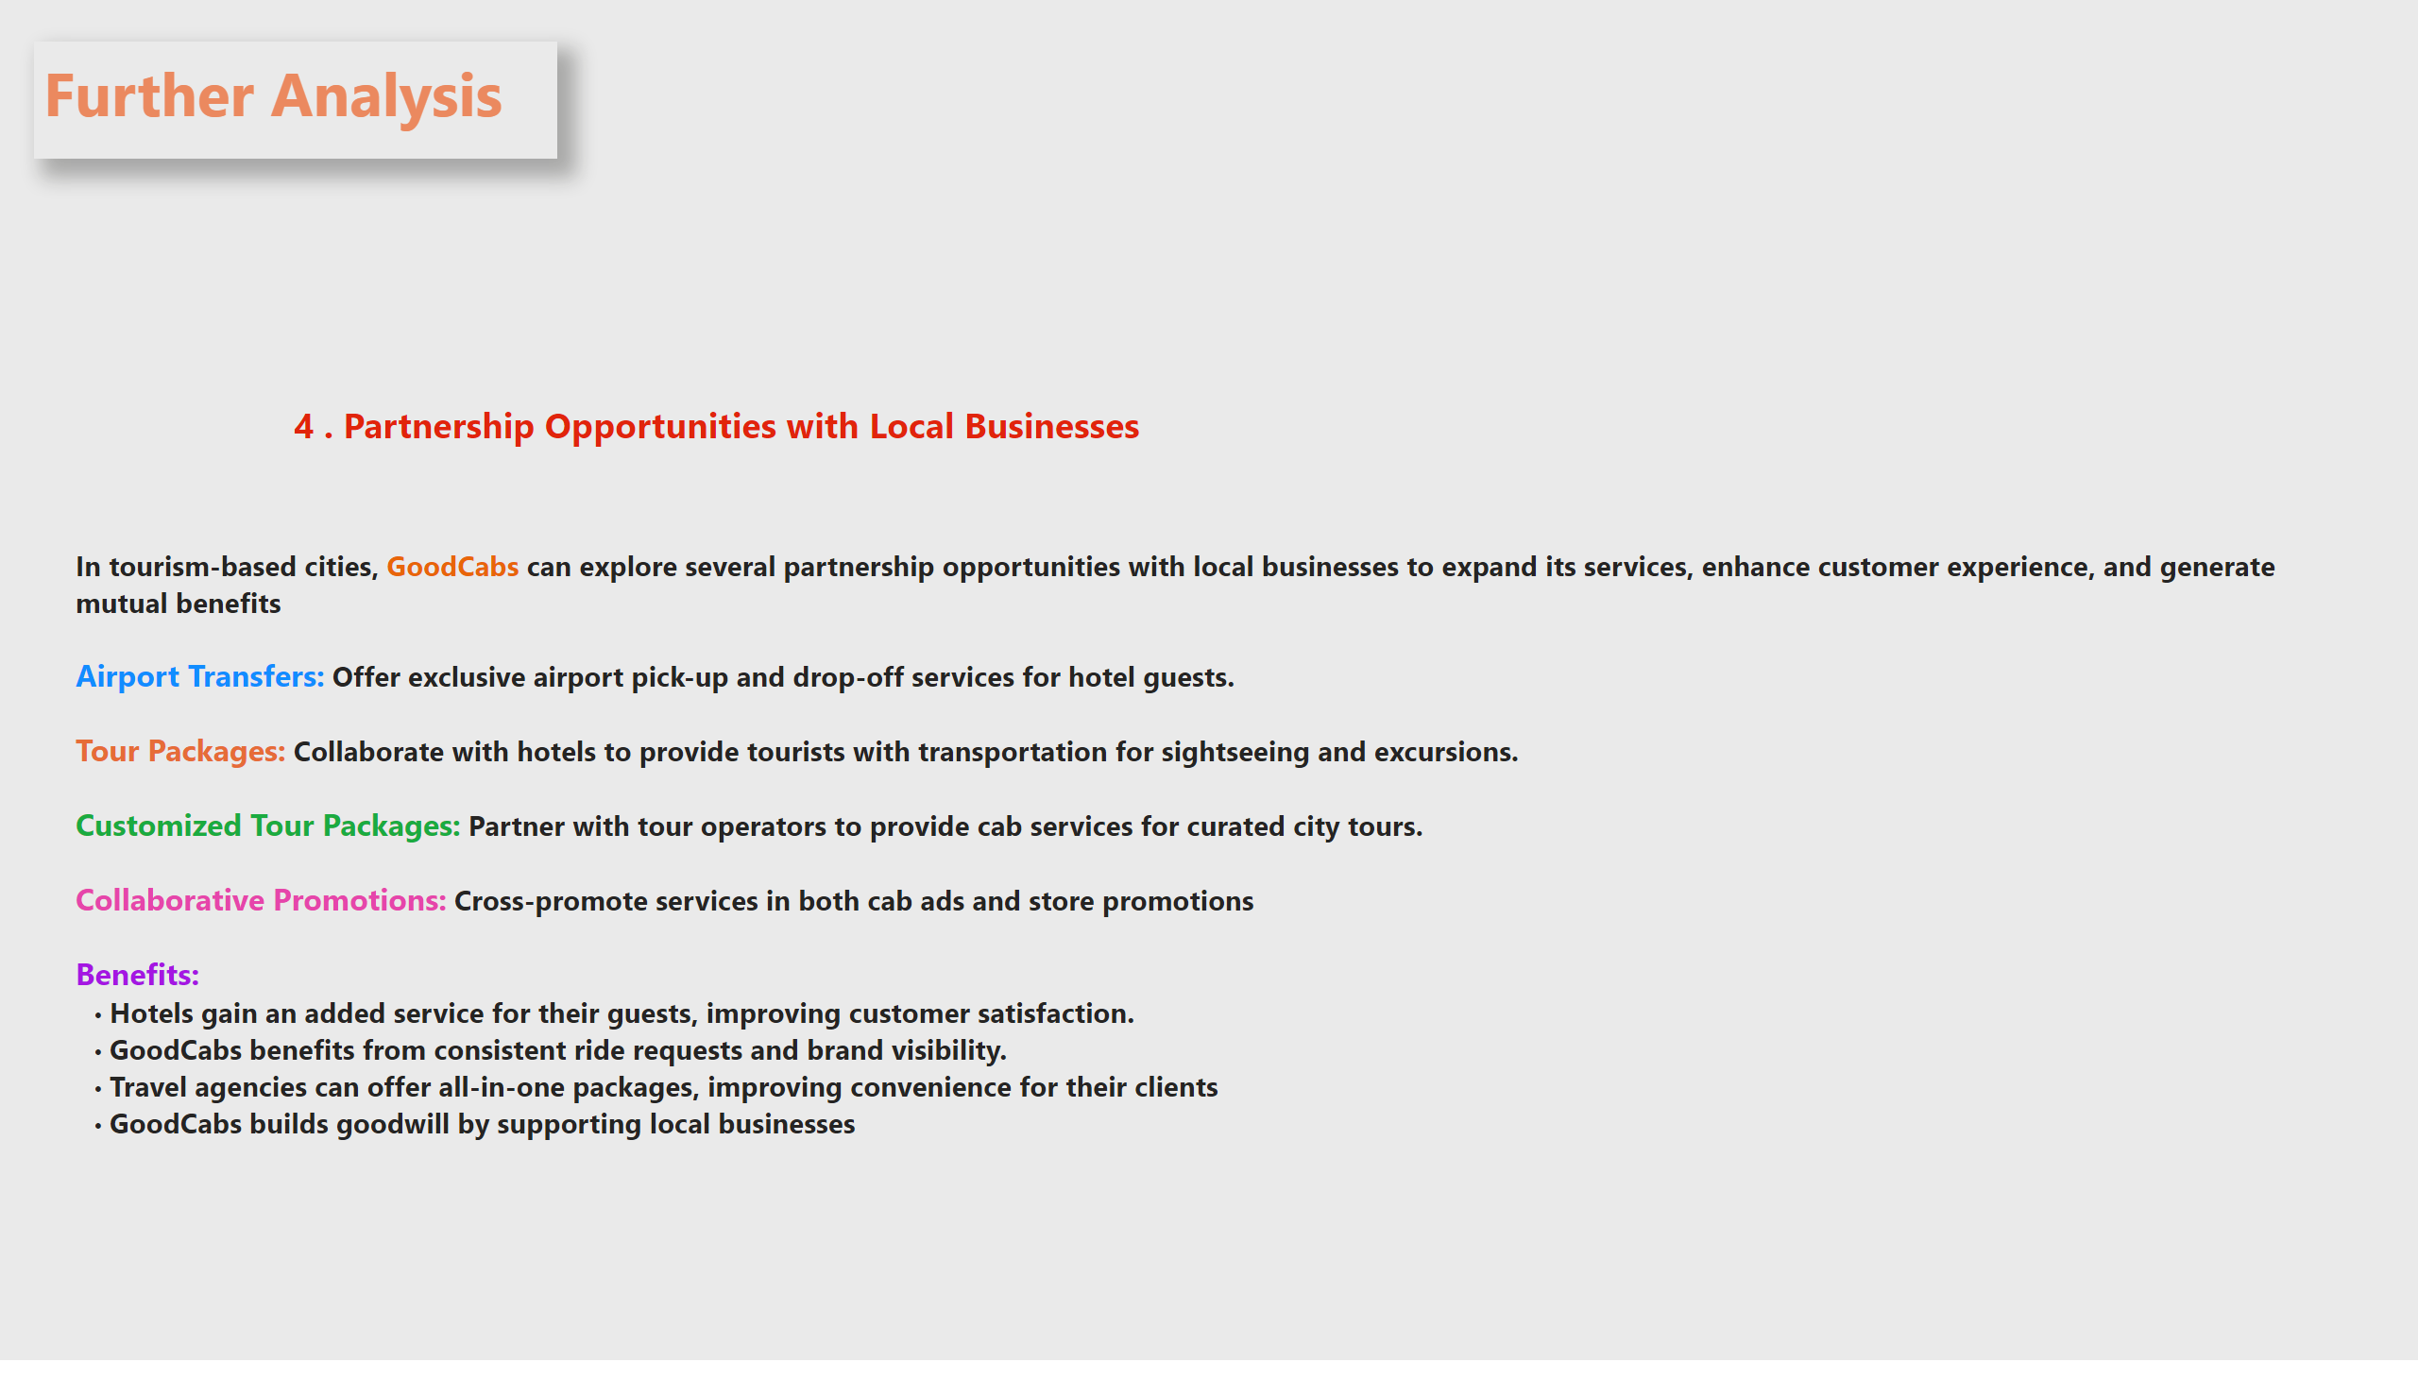
f4
Notes:
textbox
No alt text provided
textbox
No alt text provided
textbox
No alt text provided

Slide 14
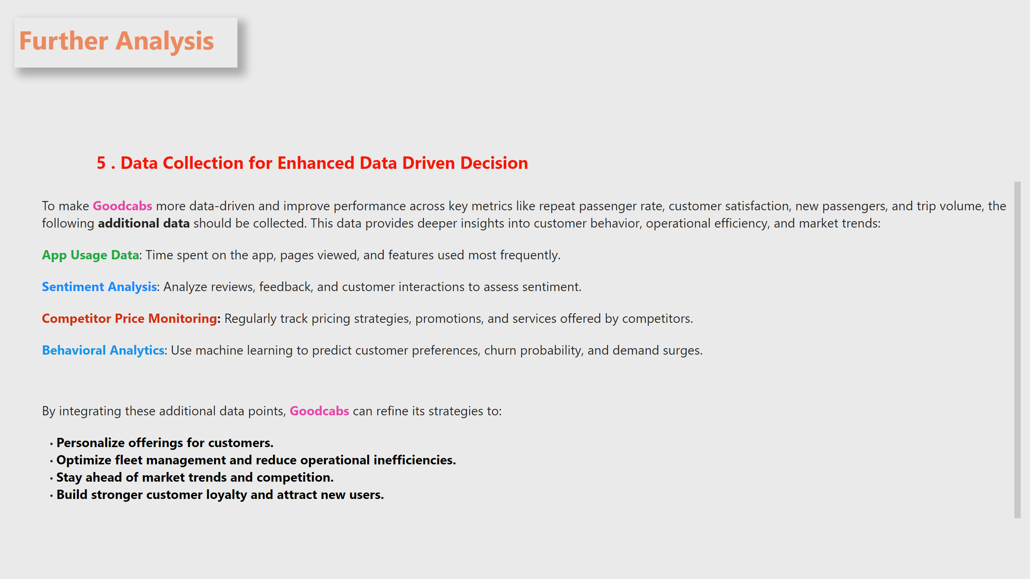
f5
Notes:
textbox
No alt text provided
textbox
No alt text provided
textbox
No alt text provided

Slide 15

THANKYOU

